Slide 1

Derate Prediction Modeling
Team Label-Free
Nashville Software School
May 21, 2026

Slide 2
Overview
Introduction (2 min)
  The Team
  Opportunity
  Solution
Project (8 min)
  Models
  Challenges
  Data
  Targets
  Actions
  Projections
Outcomes (4 min)
Conclusion (1 min)
Q & A
Appendix

Slide 3
01
Introduction
The Team
Opportunity
Solution

Slide 4
Team Label-Free
Anitha Doddala
Shannon Lee
Micheal Major
Josh Tacker
Data Scientist
Lead
Data Engineer
Data Scientist
Data Scientist

Slide 5

Opportunity
What is a vehicle derate?
Vehicle emission system sensors detect certain problematic conditions that will limit engine output. This is known as derate. A full derate or idle level derate is triggered by the fault code SPN 5246.
Effects:
  Vehicle will require a tow
  High cost of repairs
  Drastically affects customer operations
Between 2015 - 2018, repairs for full derates cost:
439 x $4,000 = $1,776,000

Slide 6
Solution
Ensemble
Neural Network
Use supervised machine learning models as a tool to predict full derates before they happen.
Random Forest
Gradient Boosting
MLP Classifier
Keras Sequential

Slide 7
02
Project
Models
Challenges
Data
Targets
Actions
Projections

Slide 8
Models
Random Forest
Multi-Layer Perceptron (MLP)
Gradient Boosting
Keras Sequential
Makes predictions by combining the results of many decision trees, where each tree looks at the data a little differently before “voting” on the final answer. This approach usually produces more reliable and accurate predictions than relying on a single decision tree because it reduces the impact of individual mistakes or overfitting.
Inspired by how the human brain processes information, using layers of connected nodes to learn patterns from data. As it trains, the model adjusts these connections over time to improve its ability to recognize relationships and make predictions on new data.
Builds many small decision trees one after another, with each new tree focusing on correcting the mistakes made by the previous ones. By gradually improving the model step by step, it can make highly accurate predictions, especially for complex patterns in data.
A simple way to build a neural network by stacking layers in order, where each layer learns increasingly complex patterns from the data. During training, the model continuously adjusts its internal connections to improve prediction accuracy and adapt to the problem it is solving.

Slide 9
Challenges
Unbalanced Dataset
Missing Values
Irrelevant Information
False Alarms
Determining a Target
False Positives
Over-fitting to the training data
Certain models cannot handle missing values
Filter out noise
Servicing can trigger false alarms
What is the best way to make a prediction
Over servicing vehicles

Slide 10
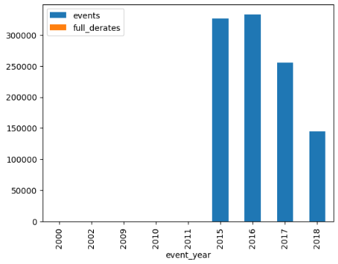
Data
Year | Events | Full Derates | Targets
2000 | 219 | 0 | 0
2002 | 1 | 0 | 0
2009 | 24 | 0 | 0
2010 | 58 | 0 | 0
2011 | 244 | 5 | 0
2015 | 325,779 | 68 | 198
2016 | 332,383 | 2,090 | 273
2017 | 254,851 | 81 | 208
2018 | 144,510 | 81 | 209

Slide 11
Targets
Multi-Class
Binary Class
Label by event time windows prior to a full derate
2 = Full derate - 2 hrs
1 = 2 - 8 hrs
0 = Other events
1 = 2 - 8 hrs
0 = Other events

Slide 12
Actions
Model Training
Data Cleaning and Transformation
Model Testing
Removed features that were missing 80% or more values and averaged the values for features missing less than 80% values
Identified true derate events and created a target prediction window between 2 - 8 hours prior to a full derate

Slide 13
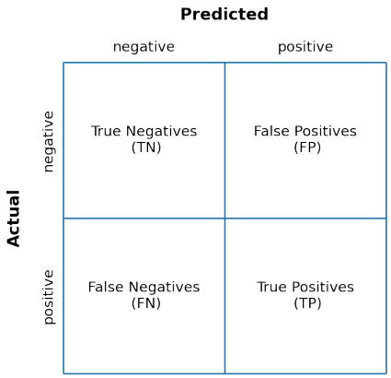

Projections
Savings = (TP * $4,000) - (FP * $500)

Slide 14
Projections
Model | True Positives | False Positives | Savings per 100 Predictions
Multi-Class MLP | 19.4% | 80.6% | $37,300
Multi-Class Keras | 54.4% | 45.6% | $194,800
2000 - 2018

Slide 15
Projections
Model | True Positives | False Positives | Savings
Multi-Class MLP | 46 | 259 | $54,500
Multi-Class Keras | 17 | 22 | $57,000
2000 - 2018
*187 Derate Targets

Slide 16
03
Outcomes
2019 - 2020

Slide 17
Outcomes
Model | True Positives | False Positives | Savings
Multi-Class MLP | 30 | 409 | -$84,500
Multi-Class Keras | 33 | 764 | -$250,000
2019 - 2020

Slide 18
04
Conclusion

Slide 19
Conclusion
The project results highlighted several challenges in developing reliable predictive models from the available data. Ensemble models did not achieve sufficient performance to justify continued training, while the multi-class MLPClassifier and Keras Sequential models experienced overfitting, limiting their ability to generalize effectively. Additionally, the binary classification Keras Sequential model generated very few predictions, reducing its practical value for identifying target events.

Slide 20
Conclusion
A significant contributor to these outcomes was the quality and structure of the dataset, particularly the heavy class imbalance and high number of missing values. These limitations made it difficult for the models to learn meaningful patterns across all target classes. External variables not represented in the data, such as newer equipment, vehicle technology advancements, or operational changes, may have also influenced the results.

Slide 21
Conclusion
Despite these challenges, the project provided valuable insight into the complexity of predictive maintenance modeling and identified several opportunities for future improvement, including enhanced data collection, additional feature engineering, and alternative approaches better suited for rare-event prediction.

Slide 22
05
Q & A
Thank You

Slide 23
06
Appendix
Full Dataset Cleaning and Transformation
Pipeline
Post-Fit
Model Training

Slide 24
Full Dataset Cleaning and Transformation
Converted ‘EventTimeStamp’ and ‘LocationTimeStamp’ to datetime objects
Converted ‘spn’ and ‘fmi’ to string values
Using sklearn.neighbors.BallTree, created column ‘NearServiceStation’ to indicate events with 1 mi. of a service station
  Near: 131367
  Not Near: 1055968
Created column IsFullDerate to indicate a full derate: 498 events
  spn = '5246'
  active = True
  NearServiceStation = False
Using regex, created column ‘Severity_Level’ to indicate code severity level based on ‘eventDescription’
  Low = 1
  Medium = 2
  High = 3
Created column Derate_Target to indicate the target labels:
  2: < 2 hr prior to and including derate (1100)
  1: Between 2 - 8 hr prior to full derate (1085)
  0: Others (1185150)

Slide 25
Full Dataset Cleaning and Transformation
Pivot diagnostic dataset wider and merge with faults dataset on RecordID/FaultID
Replace commas with decimals in numeric features
  'AcceleratorPedal',
  'BarometricPressure',
  'DistanceLtd',
  'EngineCoolantTemperature',
  'EngineOilPressure',
  'EngineOilTemperature',
  'EngineRpm',
  'EngineTimeLtd',
  'FuelLevel',
  'FuelLtd',
  'FuelRate',
  'FuelTemperature',
  'IntakeManifoldTemperature',
  'Speed',
  'SwitchedBatteryVoltage',
  'Throttle',
  'TurboBoostPressure'
Split Dataset: Training (1058069 before 2019) / Unseen (129266 after 2019)
Split Training Chronologically (Bad)

Slide 26
Pipeline
Set 2 random state variables to get reproducible results and validate ‘lucky’ initializations.
Split the data for training, validation, and testing
Impute Missing Values
  Drop features with > 80% missing values
  Use SimpleImputer most frequent for categorical features
  Use SimpleImputer mean for features with < 40% missing values
  Use IterativeImputer mean for features with > 40% missing values
One-hot encode non-numeric features
Scale features
Adjust the class weight to account for imbalanced dataset
Set early stopping to prevent overfitting
Fit model with training dataset

Slide 27
Post-Fit
Adjust threshold based on a validation dataset f1 score or fbeta score to account for imbalanced classes
Determine best fit using classification report and confusion matrix
Calculate Savings / Loss
  Filter out more than 1 prediction per day

Slide 28
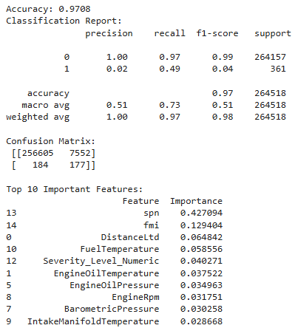

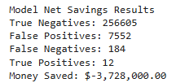
Ensemble: Random Forest
Model: ScikitLlearn Ensemble RandomForestClassifier
This method trains many decision trees using random samples of the data and features so the trees make different, less correlated predictions. The trees are trained independently in parallel, and their predictions are combined by averaging them together.
Target: Binary Derate_Target
Adjust for imbalanced classes:
Adjust the class weights
Adjust Threshold

Slide 29
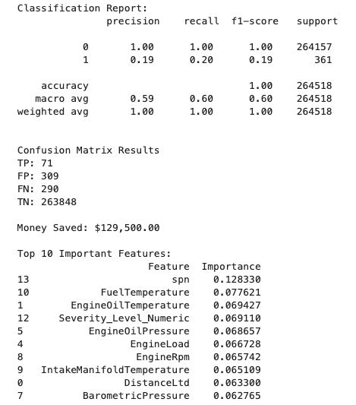

Ensemble: Gradient Boosting
Model: XGBoost XGBClassifier
Boosting trains decision trees one after another, where each new tree tries to fix the mistakes made by the previous trees. The final prediction is created by combining the trees with weighted contributions, helping improve accuracy while reducing overfitting.
Target: Binary Derate_Target
Adjust for imbalanced classes:
Adjust the class weights
Adjust Threshold

Slide 30
Neural Network: MLP Classification
Model: ScikitLearn MLPClassifier (Multi-layer Perceptron classifier)
Learns pattern by making guesses, then improving its guesses by measuring how wrong it was using log-loss.
Target: Multi-Class Derate_Target
Adjust for imbalanced classes:
Adjust the decision threshold based on f1 score or fbeta score
Manually split training and testing data chronologically
Early stopping
Split:
Train: 0.7 (Validation: 0.1)
Test: 0.2
Random State: 42, 1
Solver: adam
Activation: relu
Hidden Layers: 32, 32, 32
Early Stopping: 0.1 validation, 2 patience

Slide 31
Neural Network: MLP Classification
Target: Multi-Class Derate_Target
17 Features:
Categorical:
  ‘equipmentID’
  'spn'
  'fmi'
  'active'
  ‘Severity_Level'
Numeric:
  'BarometricPressure'
  'EngineCoolantTemperature'
  'EngineLoad'
  'EngineOilPressure'
  'EngineOilTemperature'
  'EngineRpm'
  'FuelRate'
  'FuelTemperature'
  'IntakeManifoldTemperature'
  'Speed'
  'Throttle'
  ‘TurboBoostPressure'

Slide 32
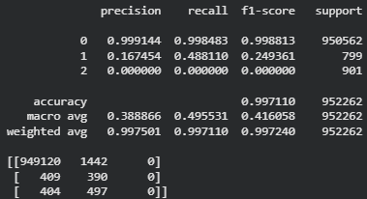
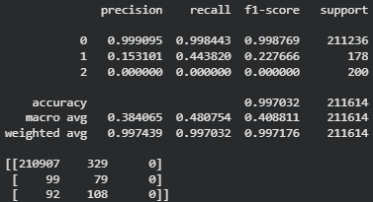
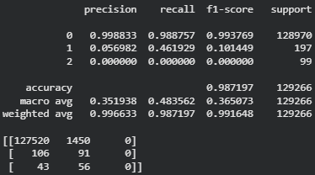
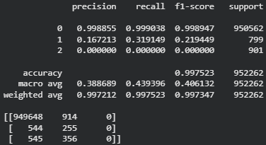
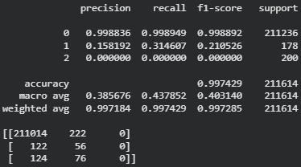
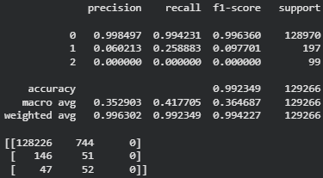
Neural Network: MLP Classification
BEST
Random State: 42
Training
Testing
Unseen
Random State: 1
TP / (TP + FP(0)) = Precision
(79) / (329 + 79) = 19.4%
100 - Precision = FP%
100 - 19.4 = 80.6%
(19.4 * 4000) - (80.6 * 500) = $37,300 per 100

Slide 33
Neural Network: Keras
Model: TensorFlow Keras Sequential
A simple way to build neural networks by stacking layers one after another
Target: Multi-Class Derate_Target
Split:
Train: 0.7 (Validation: 0.1)
Test: 0.2
Random State: 42, 1
Solver: adam
Activation: relu 64, relu 32, softmax 3
Loss: categorical_crossentropy
Metrics: Precision and Recall
Batch Size: 32
Epochs: 20
Early Stopping: 0.1 validation, patience 2
Class Weight: 1, 2, 1
Adjust for imbalanced classes:
Adjust the decision threshold based on money saved and F-beta score
Adjust the class weights

Slide 34
Neural Network: Keras
Target: Multi-Class Derate_Target
17 Features:
Categorical:
  ‘equipmentID’
  'spn'
  'fmi'
  'active'
  ‘Severity_Level'
Numeric:
  'BarometricPressure'
  'EngineCoolantTemperature'
  'EngineLoad'
  'EngineOilPressure'
  'EngineOilTemperature'
  'EngineRpm'
  'FuelRate'
  'FuelTemperature'
  'IntakeManifoldTemperature'
  'Speed'
  'Throttle'
  ‘TurboBoostPressure'

Slide 35
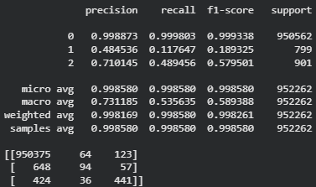
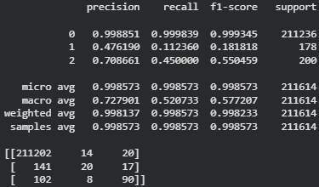
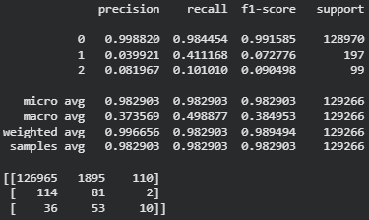
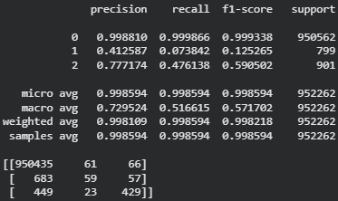
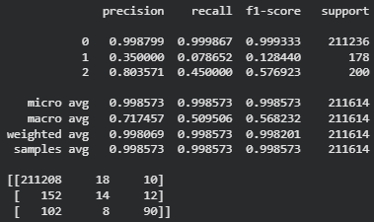
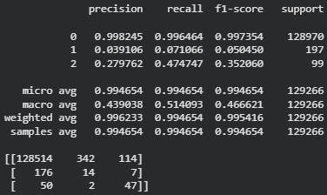
Neural Network: Keras Sequential
BEST
Training
Testing
Unseen
Random State: 1
TP / (TP + FP(0)) = Precision
(20) / (20 + 14) = 58.8%
100 - Precision = FP%
100 - 58.8 = 42.2%
(58.8 * 4000) - (42.2 * 500) = $37,300 per 100

Slide 36

Neural Network: Keras
Best model:
Target: 'Derate_Target_8.0-2.0'
Split:
Train: 0.7 (train-75%, val-25%)
Test: 0.3
Activation:
Dense Layer : relu 64 Neurons+ReLU with 20% dropout
Dense Layer : relu 32 Neurons+ReLU with 20% dropout
Output: Sigmoid activation
Handled Imbalanced Data:

Slide 38
Multiple records existed for each equipment
Predictions aggregated by:
  EquipmentID
  Event Date
And we used
sum of predictions to count warning signals
max of target to determine actual failure occurrence”
Equipment and Daily Aggregation

Slide 39
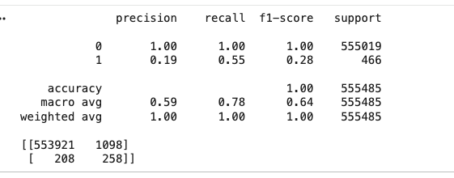
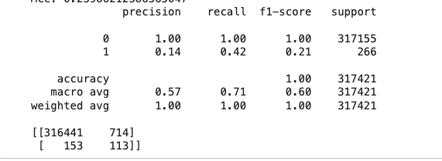
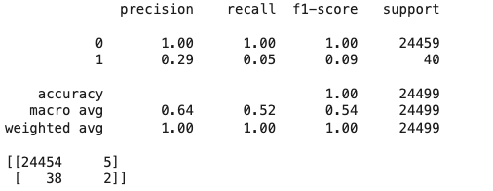
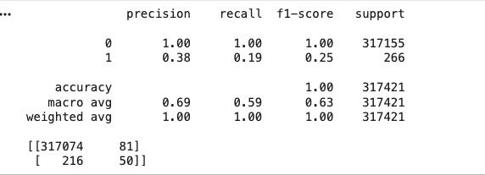
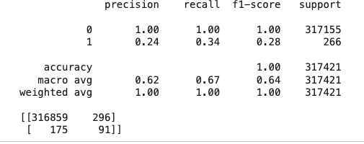
Neural Network: Keras Sequential
Training
Testing
Unseen
Validation -Threshold-0.74
TP / (TP + FP(0)) = Precision
(113) / (714+ 113) =14%
100 - Precision = FP%
100 - 14 = 86%
(14 * 4000) - (86 * 500) = $13000 per 100

